Slide 1




Git & Github: Essential Tool for Modern Development
GitHub Basics

Slide 2

GitHub Basics

Slide 3
What is GitHub?
Code Cloud Drive
Time Machine
Team Office
Like Google Drive for code. Store, access & restore files anytime.
Full history of every change. Revert to any past version in one click.
100+ developers work on one project simultaneously without conflicts.
100M+ Developers
420M+ Repositories
Microsoft (2018)
#1 Code Platform
GitHub Basics

Slide 4
Git vs Github?
GitHub Basics

Slide 5
Repository — Your Project Folder
📁 src/
Source Code
HTML, CSS, JS, Python files
📄 index.html
📄 style.css
README.md
📁 images/
Project story & how to use
📄 logo.png
Commit History
📄 README.md
Who changed what & when
📄 .gitignore
Public / Private
You control who sees it
GitHub Basics

Slide 6
Git Workflow — How It Works
1
2
3
4
Write Code
Commit
Push
Pull
Edit files on your computer
→
Snapshot with a message
→
Upload to GitHub cloud
→
Download team updates
$ git add . → $ git commit -m "New feature" → $ git push origin main
GitHub Basics

Slide 7
Branching — Parallel Paths, One Goal
feature/login
What is a Branch?
main — Always working code
main
feature — Test new work
fix — Bug fixes safely
Merge — Combine when ready
fix/crash-bug
💡 Every developer works in their own branch — main stays safe!
GitHub Basics

Slide 8
Pull Requests & Code Review
1
2
3
4
Write Code
Open PR
Review
Merged!
Developer built a new feature
→
"Please merge my changes!"
→
Team checks & comments
→
Approved & added to main
✅ Open
#247 opened 2 hrs ago by ali-dev | 3 files changed | +152 -23 | 2 reviewers
Merge PR
GitHub Basics

Slide 9
Issues & Project Management
Project Board
🐛 Bug Report
To Do
In Progress
Done
Something broken — needs fixing!
Login UI
API fix
CI Setup
🚀 Feature Request
Add new functionality to project
Dark Mode
Tests
Docs
✨ Enhancement
Improve existing features
GitHub Issues = Whole team on one page. No task gets missed!
GitHub Basics

Slide 10
GitHub Actions — Your Robot Worker
1
2
3
4
Code Push
Tests Run
Build
Live!
⚡
⚡
⚡
git push
Automatic!
Deploy ready
On server
GitHub Basics

Slide 11
GitHub Features — Complete Overview
📁 Repository
🌿 Branches
💬 Commits
🔀 Pull Requests
Store & manage all project files
Work on features without breaking main
Save snapshots with messages
Review & merge code changes
🐛 Issues
⚡ Actions
🌐 Pages
🔒 Security
Track bugs, tasks & feature requests
Automate tests, builds & deploy
Host your website FREE on github.io
Auto-detect & fix vulnerabilities
GitHub Basics

Slide 12
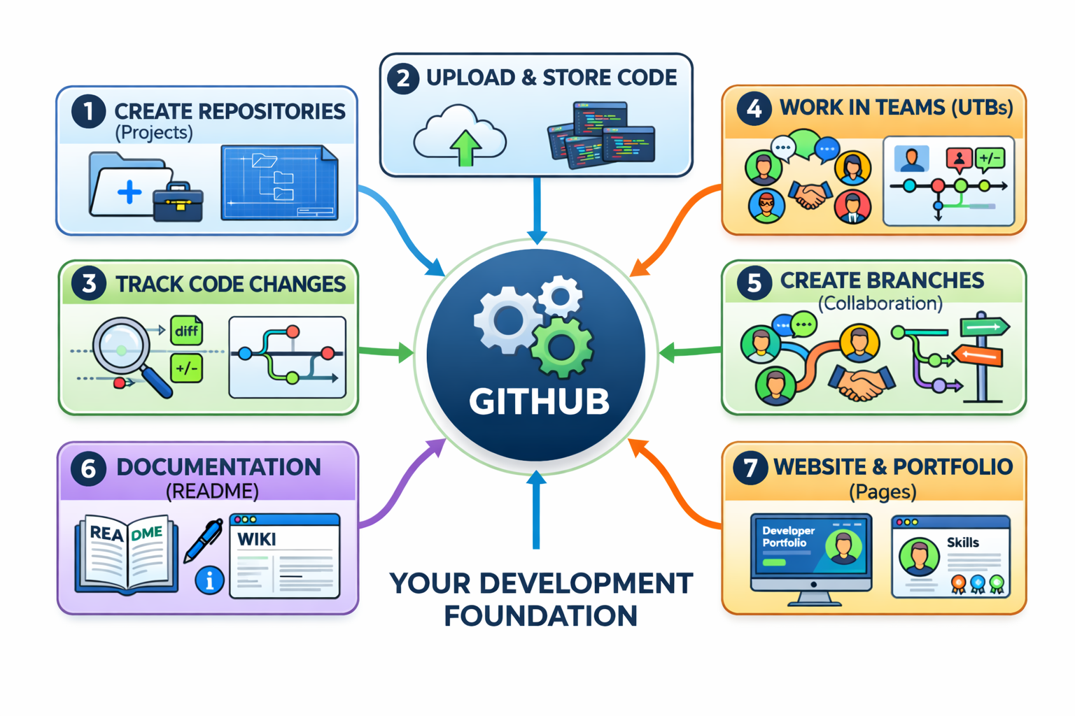
What can we do on github?

Slide 13
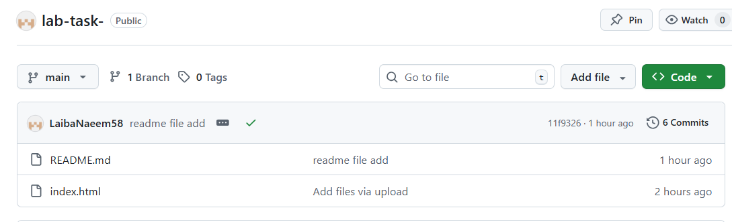

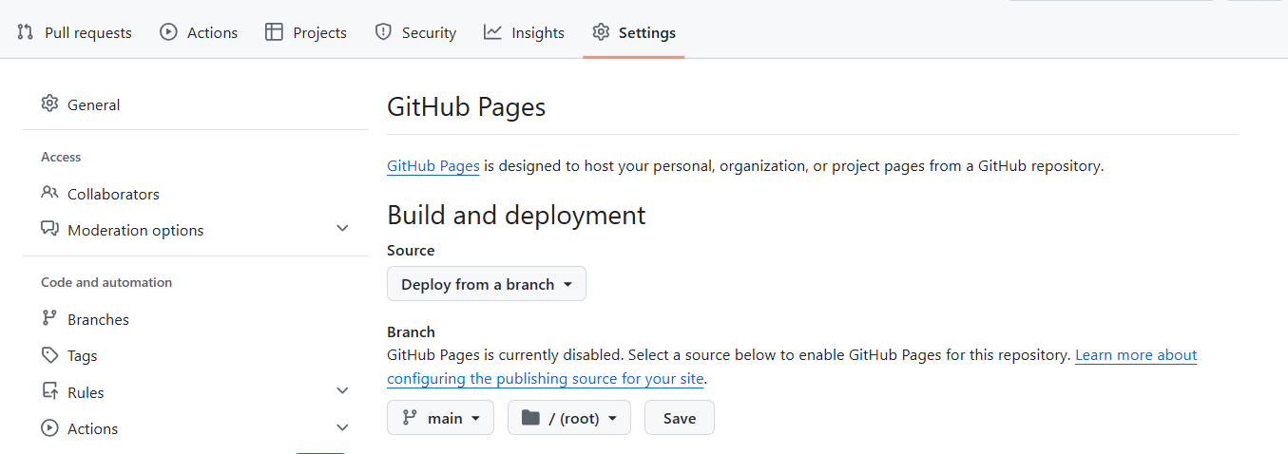
Team Collaboration:
13
13
GitHub Basics

Slide 14
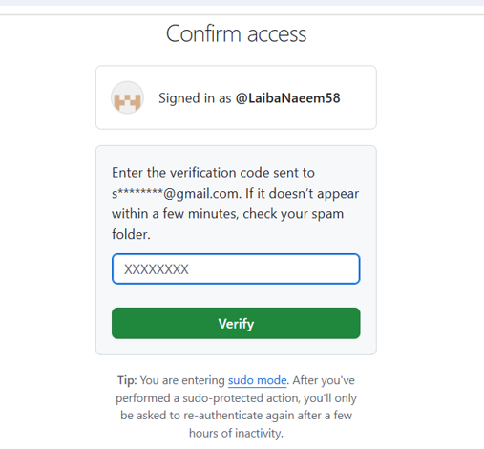
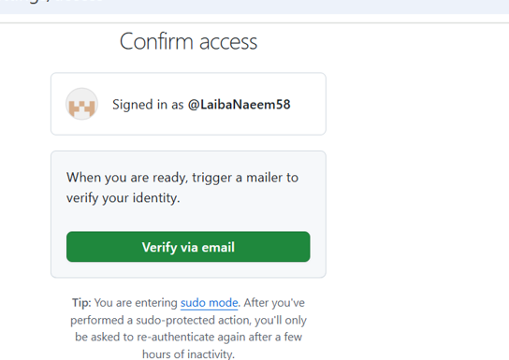
GitHub Basics

Slide 15
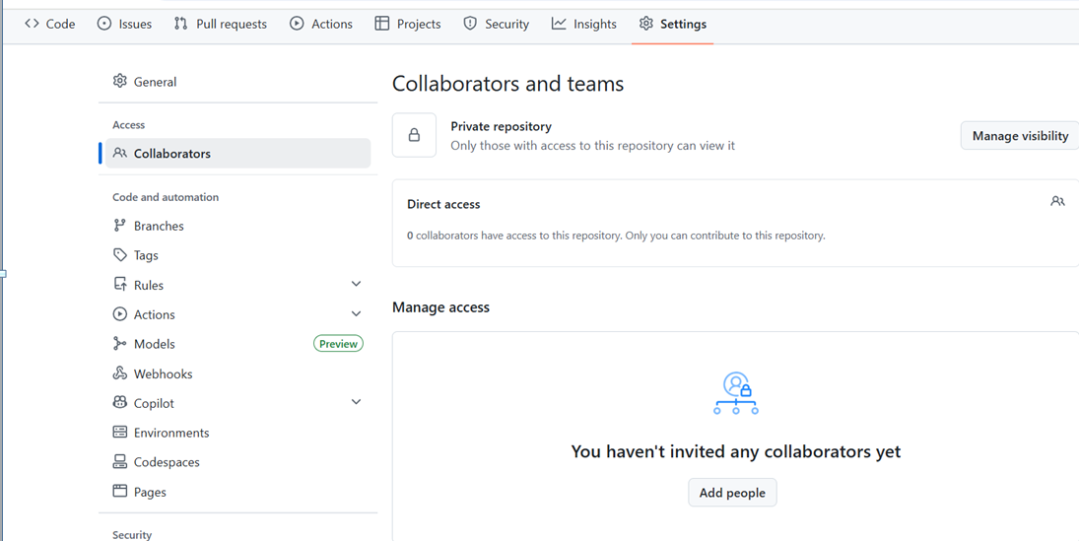
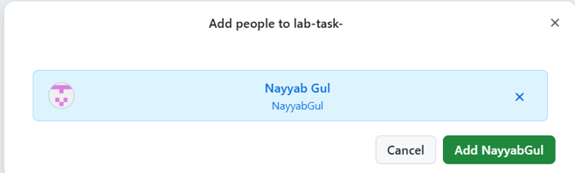
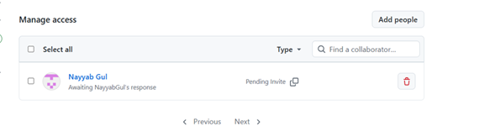
GitHub Basics

Slide 16
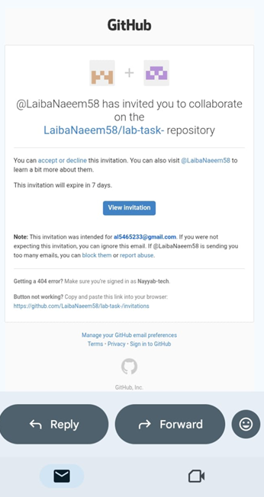
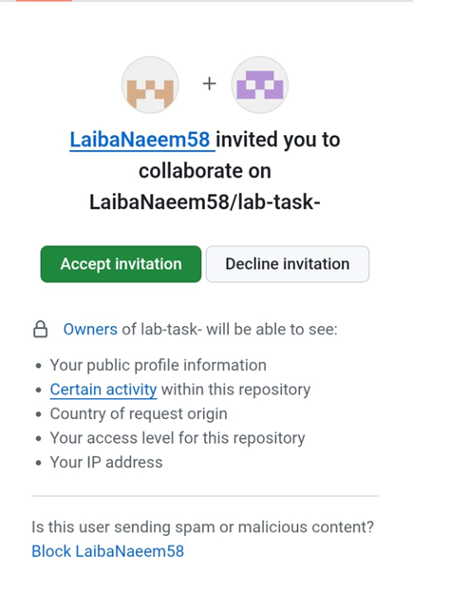
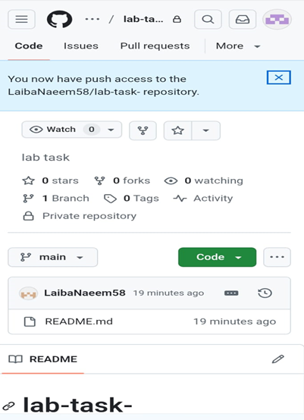
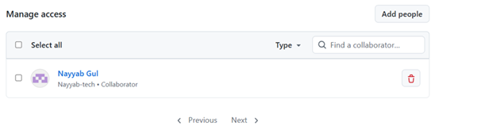
16
GitHub Basics

Slide 17
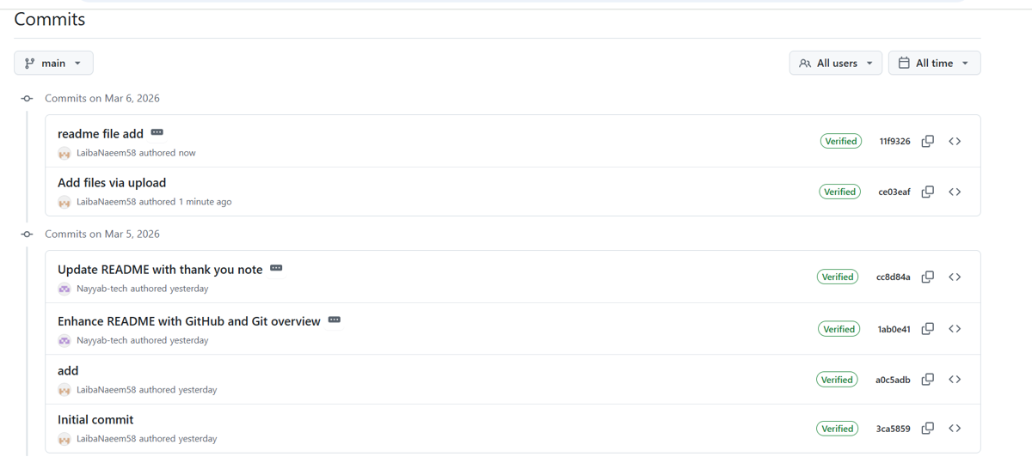
17
17
GitHub Basics

Slide 18
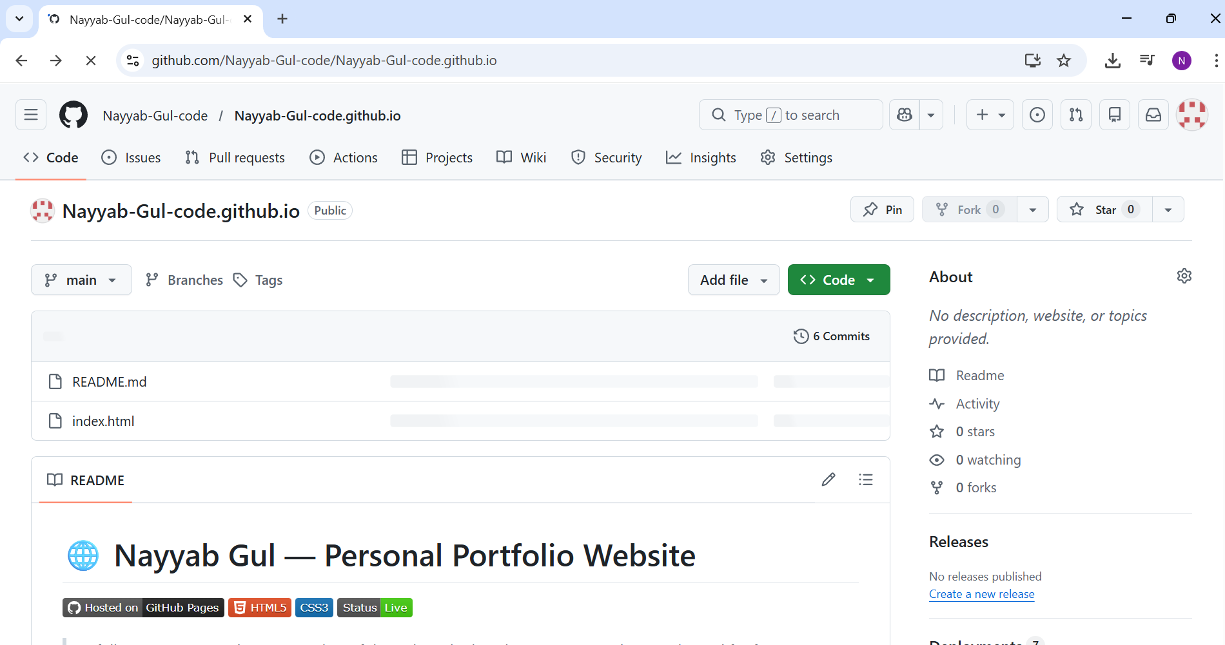
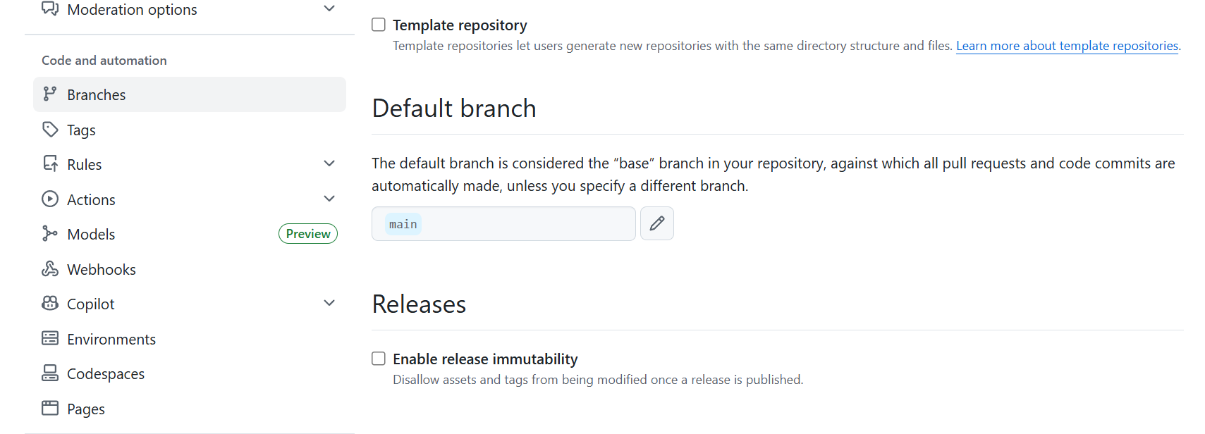
Website
18
GitHub Basics

Slide 19
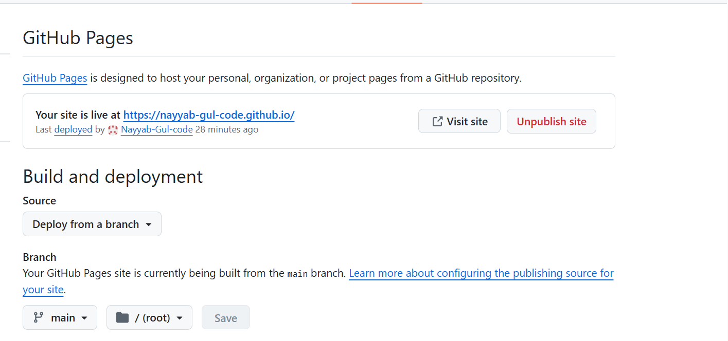
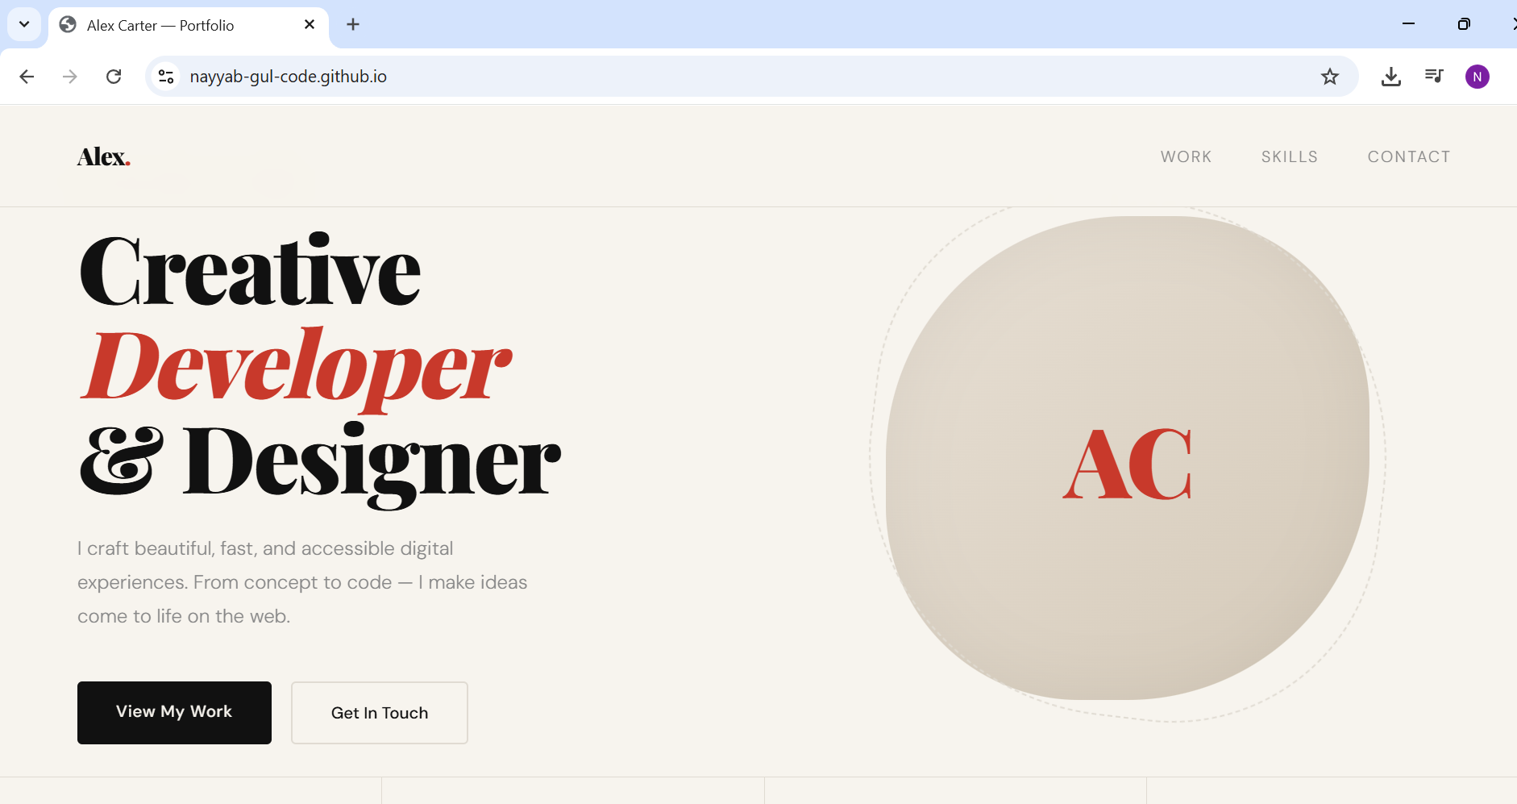

Slide 20
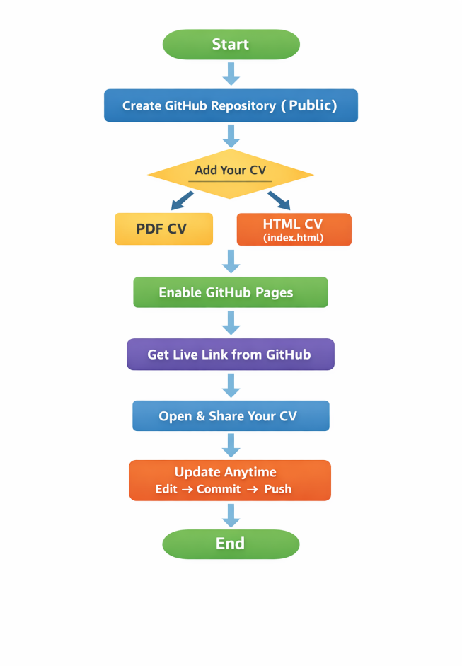
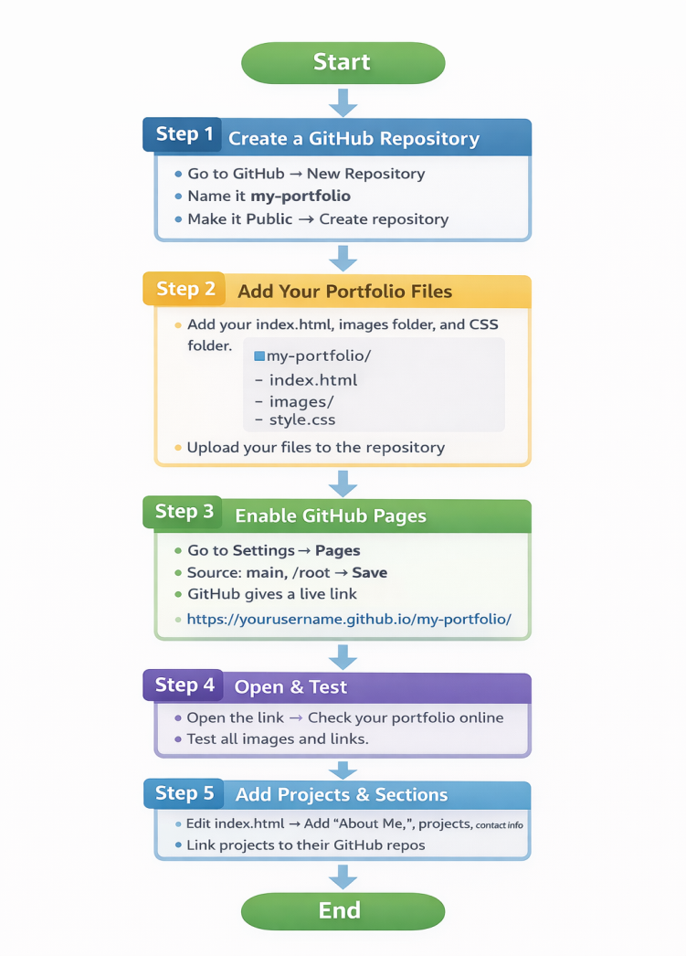
Portfolio
CV
GitHub Basics

Slide 21
GitHub Repository Management
GitHub Basics

Slide 22
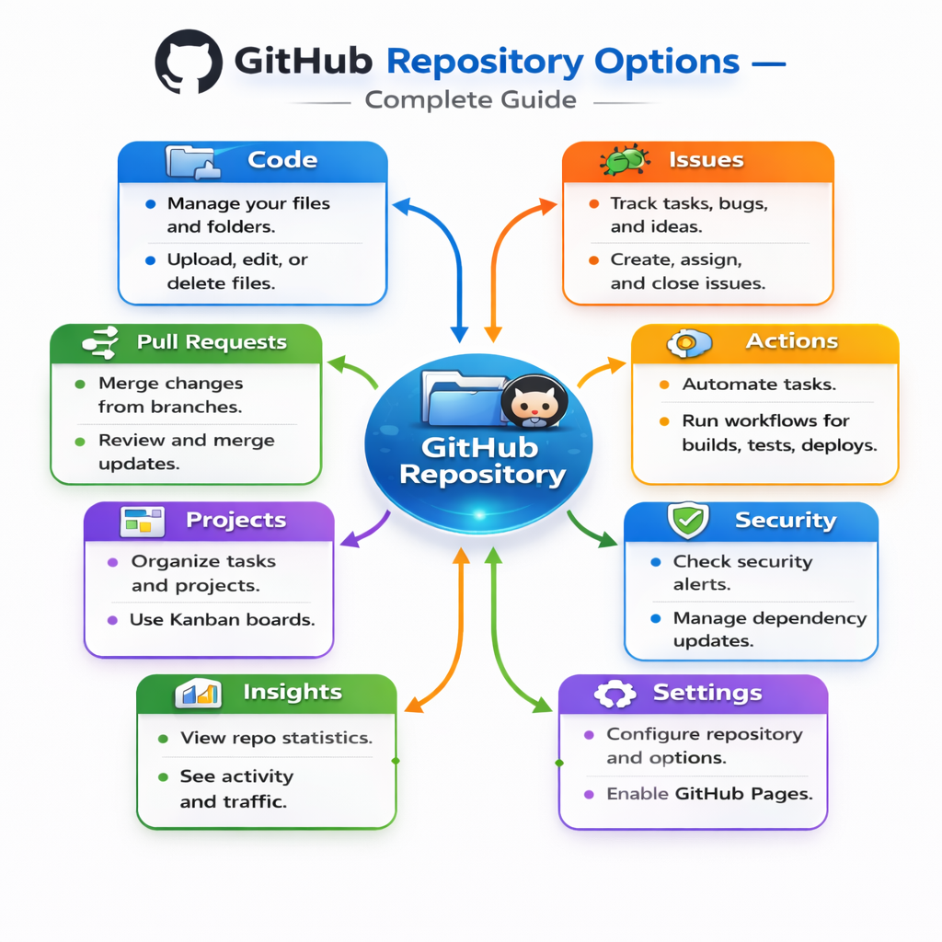

Slide 23
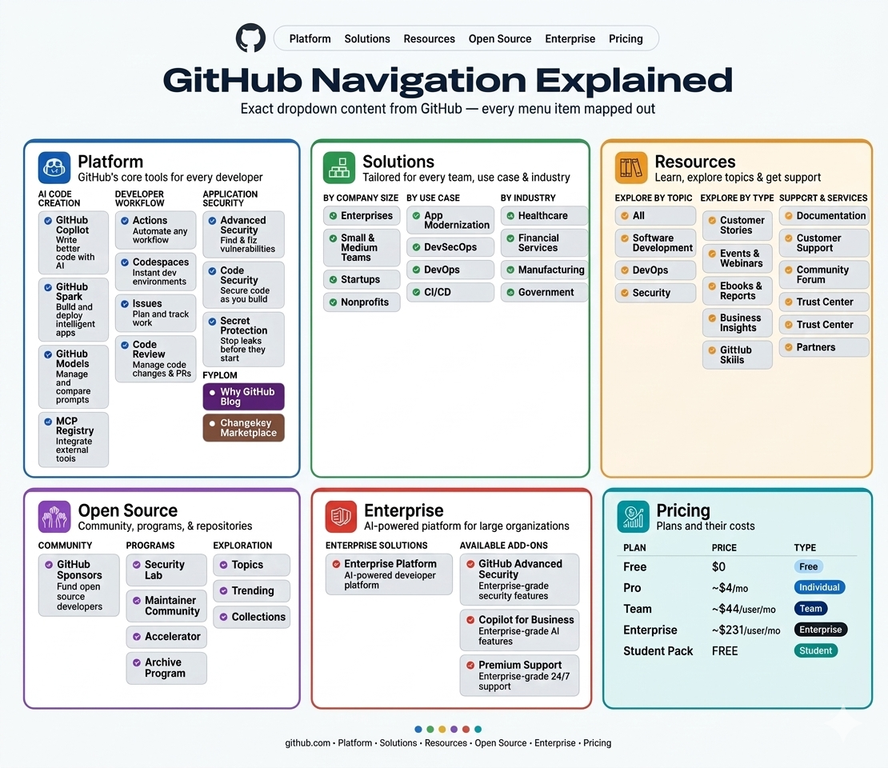

Slide 24
Github alternatives
Gitlab
Bitbucket
AWScode commit etc
Which is Best?
GitHub is the best — largest community, 100M+ developers, and most companies require it.
If you want all-in-one DevOps → GitLab is second best!
GitHub Basics

Slide 25


Slide 26
Thank you!
26
GitHub Basics

